Slide 1
MoAD
Chapter 2: User Interface
Mahesh S Patil

Slide 2
Creating UI
User interfaces can be designed using one of two methods:
Procedural
Declarative
Similar to Java Swings
Tags like HTML, XML shall be used

Slide 3
Creating UI: Declarative
An XML file in res/layout defines the UI for an activity
onCreate() of activity is used to setup the UI
Each activity gets an View through setContentView( ) API
setContentView( ) fills in the contents of the activity’s screen with an Android view widget.
At runtime, Android parses and instantiates (inflates) the resource defined there and sets it as the view for the current activity.

Slide 4
Revisit to R.java
public final class R {
public static final class attr {
}
public static final class drawable {
public static final int icon=0x7f020000;
}
public static final class layout {
public static final int main=0x7f030000;
}
public static final class string {
public static final int app_name=0x7f040001;
public static final int hello=0x7f040000;
}
}
R class is managed automatically by the Android
It notices the change and adds resource IDs in R.java
The hex numbers are just integers that the Android resource manager uses to load the real data, the strings, and the other assets

Slide 5
Hands-On
Launch an activity from main activity through a button
Whats aapt?

Slide 6
Views
Are the rectangle we see on screen
Its basic class, all others extend from it
Responsible for drawing and events handling

Slide 7
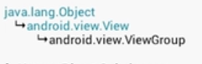
View Groups
Extends View
Container for children views
1) Frame layout
One child can be added , sits on top left of container
If another is added , then it will overlap previous child

Slide 8
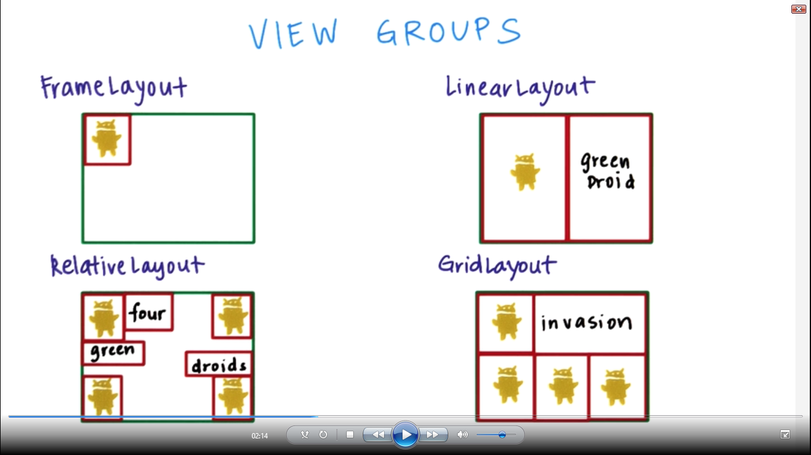
Layouts

Slide 9
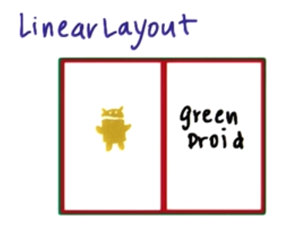
2) Linear layout
Here the weight param is 1 and 1 for inner views

Slide 10
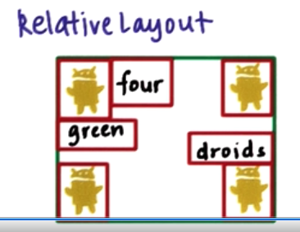
Relative layout

Slide 11
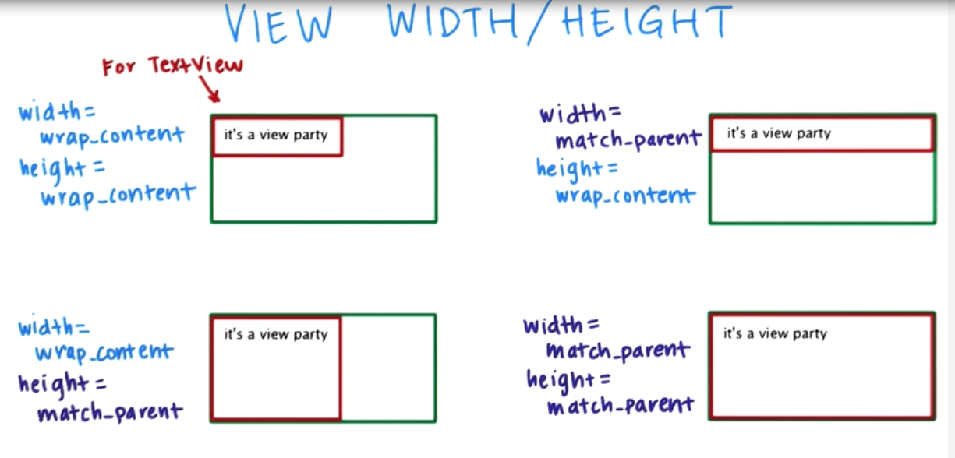
View height /width

Slide 12
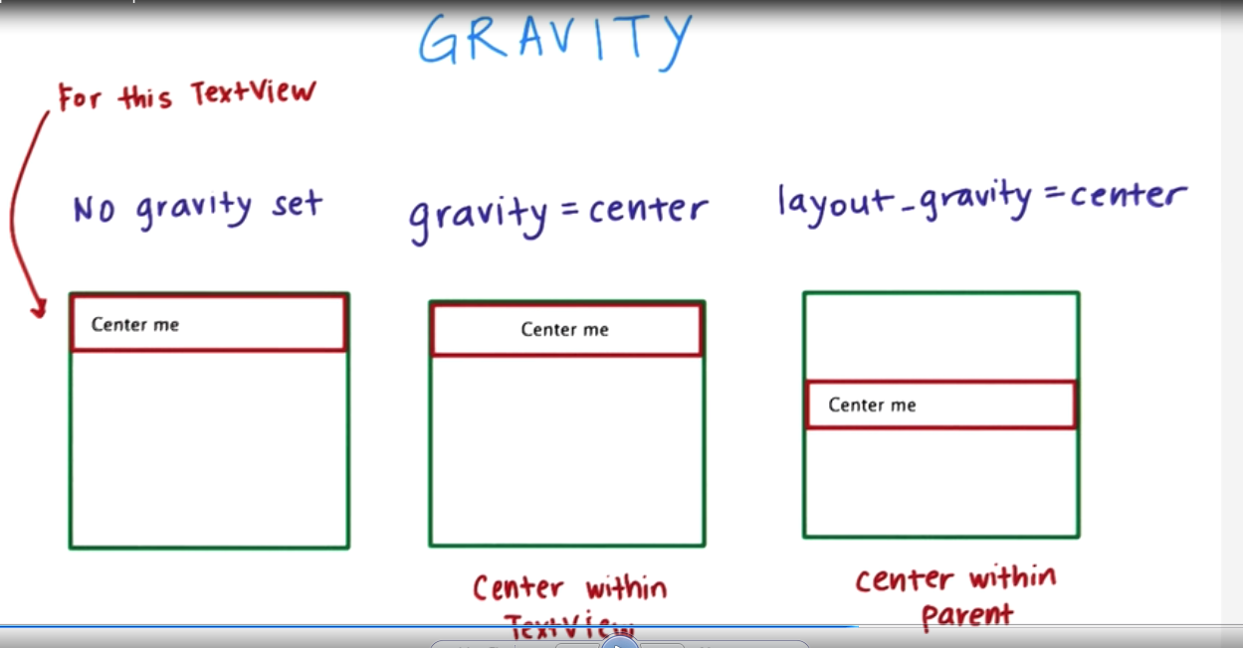
Gravity

Slide 13
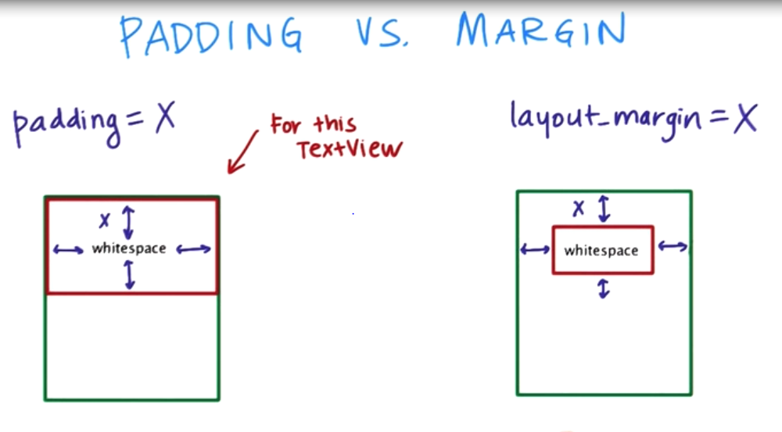
Padding vs margin

Slide 14
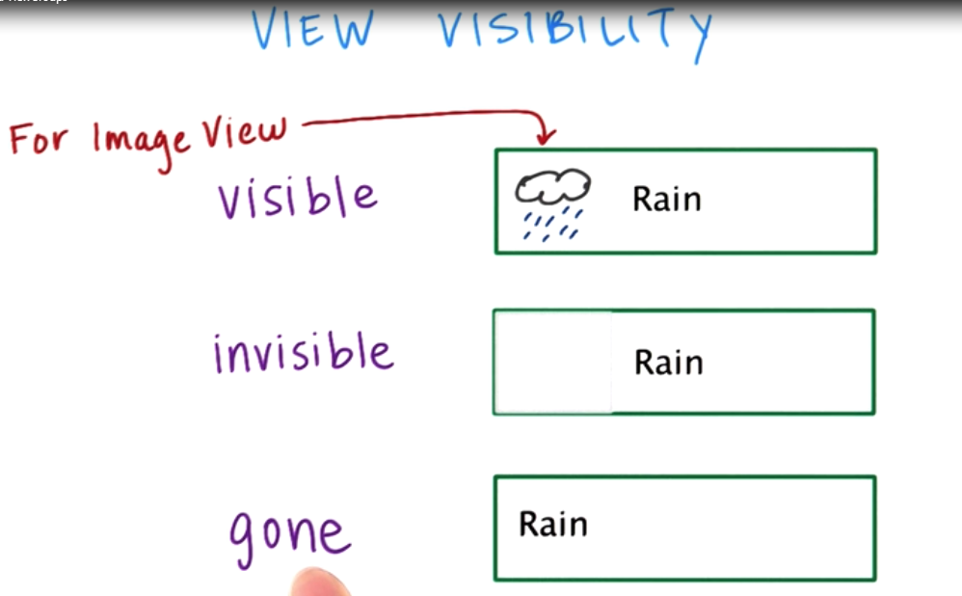
View visibility

Slide 15
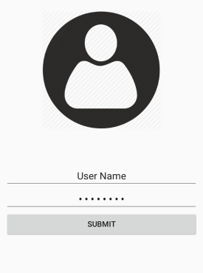
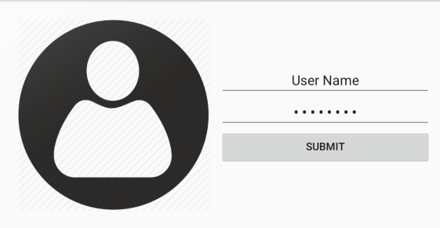
Hands-on
Implement UI with following wire-frame
Create some dummy user credentials
On clicking the submit button display a Toast with suitable logging message. i.e. “success” if user enters valid user name and password

Slide 16
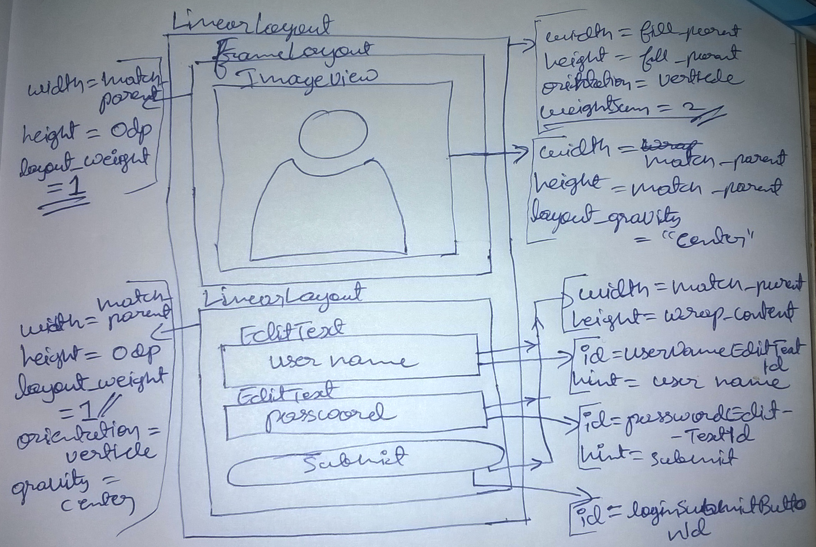
UI wireframe format to be written in Exams

Slide 17
Refer textbook 3.4 topic, to explore TableLayout

Slide 18
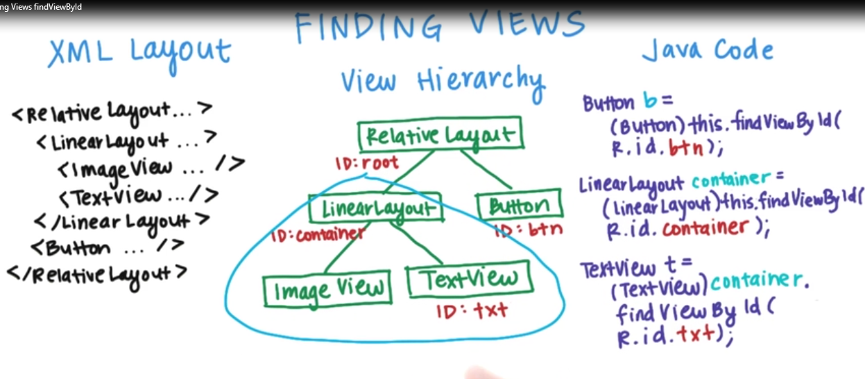
Finding Views by Id’s

Slide 19
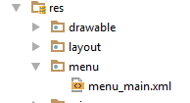
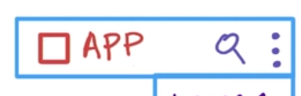
Adding Menu
Menu option are declared in XML
From XML it is inflated as menu item in the app
Menu items are ordered from most frequently used to less frequently used.
Few Menu items can also be within the action bar

Slide 20
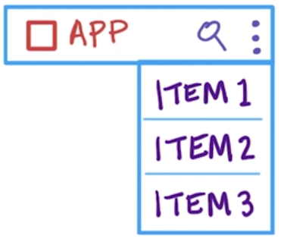
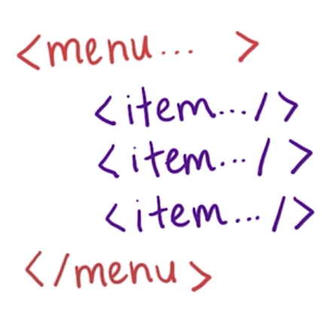


Slide 21
Adding menu
Create menu XML in res/menu and include the item
<item android:id="@+id/reset_m_item" android:title="@string/reset_str" />
In activity class override following method
public boolean onCreateOptionsMenu(Menu menu) { getMenuInflater().inflate(R.menu.login_menu,menu); return true; }
Then attach listener to menu by overriding
public boolean onOptionsItemSelected(MenuItem item) { int clicked_item_Id=item.getItemId(); return super.onOptionsItemSelected(item); }

Slide 22
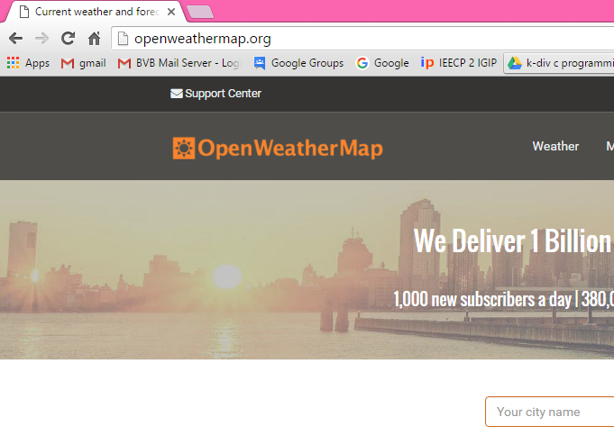
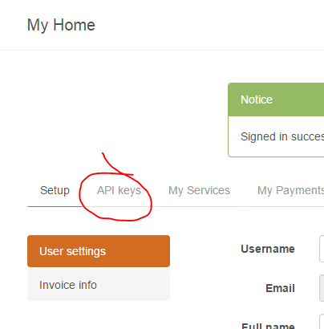
http://api.openweathermap.org/
Sign-up
Get your
API KEY
It is required for
further demo
programs

Slide 23
ListView
ListView is a view group that displays a list of scrollable items.
Subclass of AdapterView<android.widget.ListAdapter>
The list items are automatically inserted to the list using an Adapter that pulls content from a source such as an array or database query and converts each item result into a view that's placed into the list.
Adapter holds the data and send the data to adapter view
view takes the data from view and shows the data on different views like as spinner, list view, grid view etc.
ListView and GridView are subclasses of AdapterView
The common adapters are ArrayAdapter,Base Adapter,CursorAdapter, SimpleCursorAdapter,SpinnerAdapter andWrapperListAdapter

Slide 24
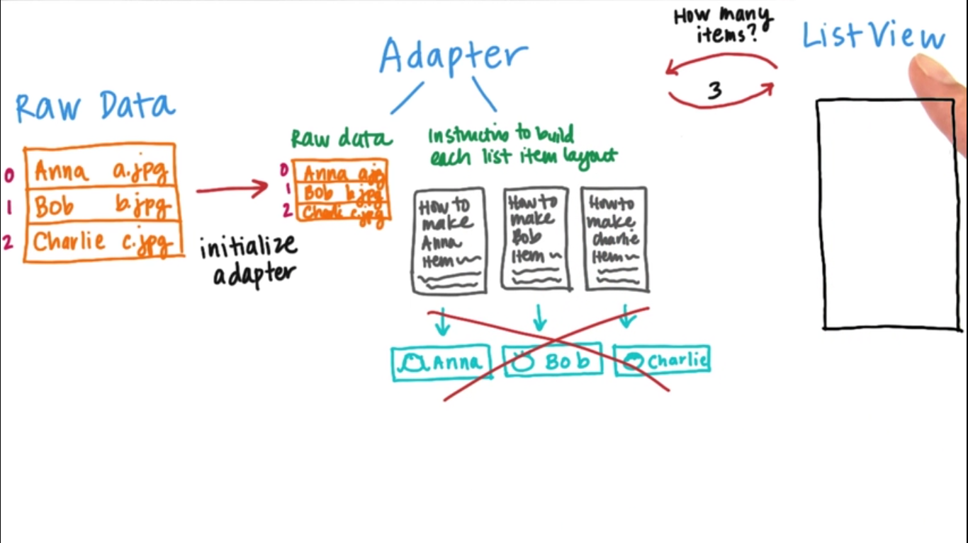
ListView

Slide 25
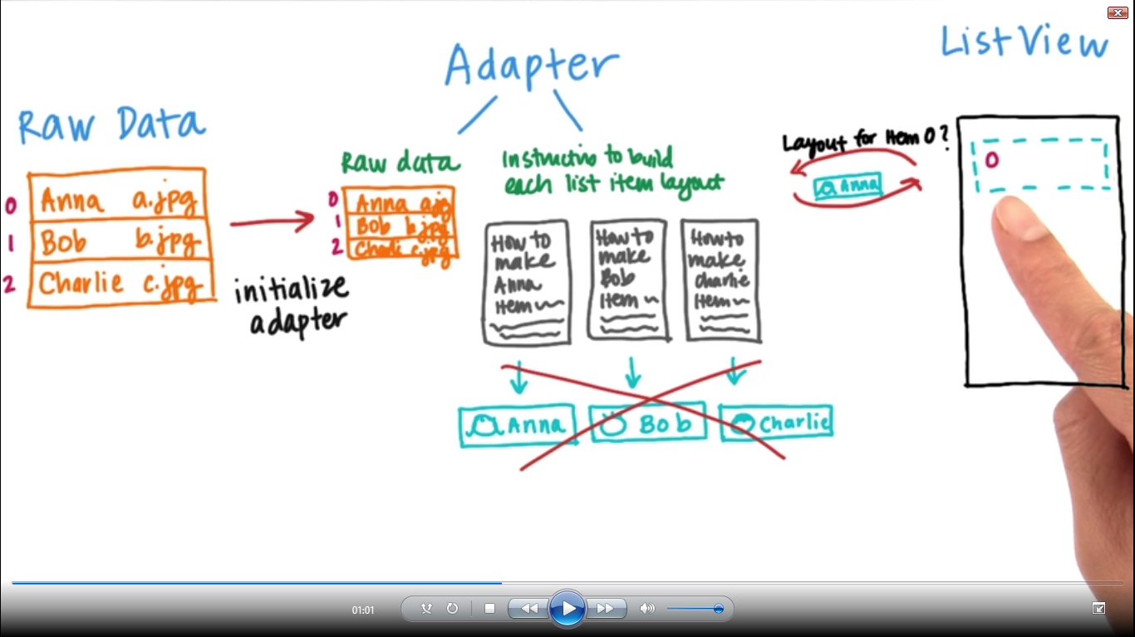
ListView

Slide 26
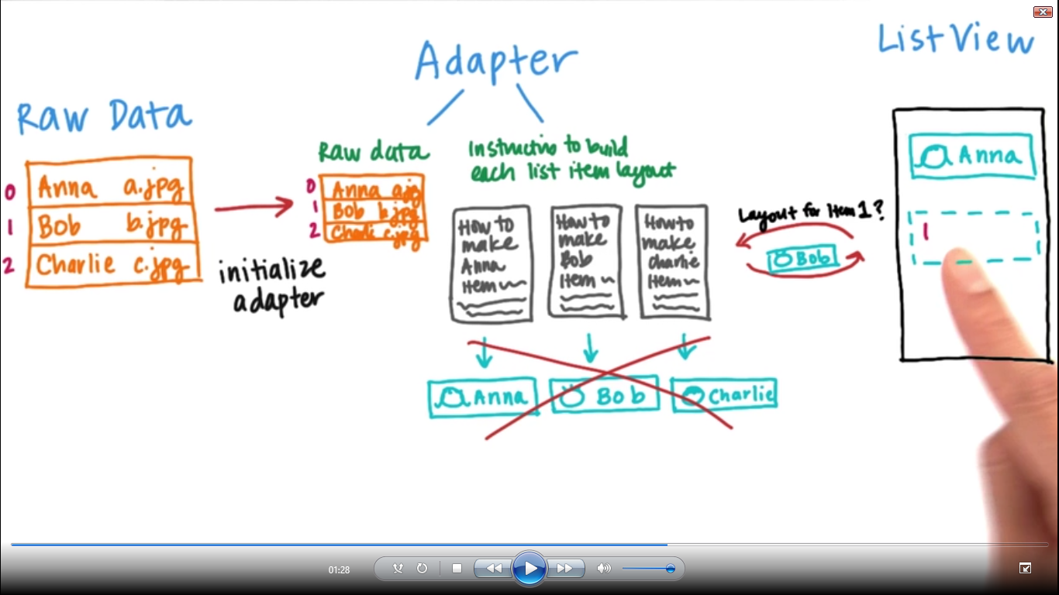
ListView

Slide 27
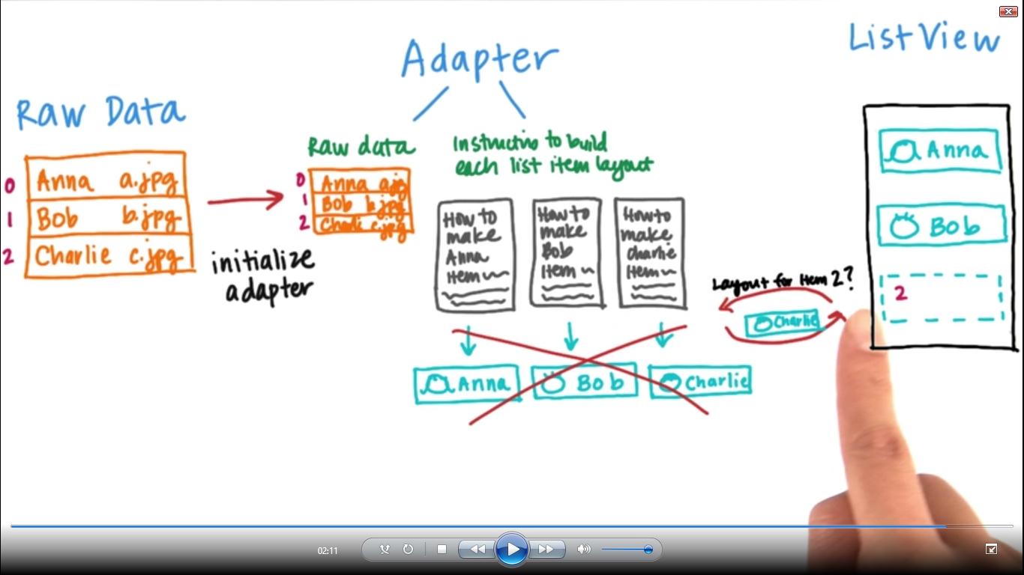
ListView

Slide 28
ListView: demo steps
Step | Description
1 | Create an activity listViewActivity.java
2 | Modify the default content of res/layout/activity_list_view.xml file to include ListView content with the self explanatory attributes.
3 | Create a Text View id:listItemId in new layout file res/layout/listview_item.xml. Text view itself is the root view. This file will have setting to display all the list items. So you can customize its fonts, padding, color etc. using this file.

Slide 29
ListView: demo steps
4 | In the listViewActivity.java onCreate() method add following code arrayList=new ArrayList<String>(); arrayList.add("cloud computing"); arrayList.add("Moabile Apllication Development"); arrayList.add("Information security"); arrayList.add("Data minint"); arrayList.add("data structures"); arrayList.add("operating system"); arrayList.add("java"); arrayList.add("Database management system"); arrayAdapter=new ArrayAdapter<String>(this,R.layout.listview_item,R.id.listItemId,arrayList); listView=(ListView)findViewById(R.id.listViewId); listView.setAdapter(arrayAdapter);
5 | Now following add listener code listView.setOnItemClickListener(new AdapterView.OnItemClickListener() { @Override public void onItemClick(AdapterView<?> parent, View view, int position, long id) { Log.i("ListItem","list view item clicked"); Toast.makeText(ListViewActivity.this, arrayAdapter.getItem(position), Toast.LENGTH_SHORT).show(); } } );

Slide 30
Shared preferences: Storing data
Data persistency
Shared preferences
SQLlite
InstanceBundle

Slide 31
Shared preferences
Shared Preferences allow you to save and retrieve data in the form of key, value pair.
Its file with name and contains key, value pairs.
SharedPreferences sharedpreferences = getSharedPreferences(MyPREFERENCES, Context.MODE_PRIVATE);

Slide 32
Shared preferences
You can save something in the sharedpreferences by using
SharedPreferences.Editor class
Editor editor = sharedpreferences.edit(); editor.putString("key", "value");
editor.commit();
To read data from shared preference
sharedpreferences.getString(“key", “defaultValue");

Slide 33
Hands-On
Once the user logs in successfully, the user credentials must be stored persistently

Slide 34
Settings
Instead of using View objects to build the user interface, settings are built using various subclasses of the Preference class that you declare in an XML file.
A Preference object is the building block for a single setting.
Each Preference appears as an item in a list and provides the appropriate UI for users to modify the setting.
Each Preference you add has a corresponding key-value pair that the system uses to save the setting in a default SharedPreferences

Slide 35
Settings
Preferences
Every setting for your app is represented by a specific subclass of the Preference class.
A few of the most common preferences are:
CheckBoxPreference
ListPreference
EditTextPreference

Slide 36
Settings : Demo
Step | Description
1 | Create an xml settings_xml.xml under res/xml and add following code to it <PreferenceScreen xmlns:android="http://schemas.android.com/apk/res/android"> <CheckBoxPreference android:key="pref_music" android:title="@string/pref_music" android:summary="@string/pref_music_summ" android:defaultValue="true" /> <ListPreference android:key="pref_level" android:title="@string/pref_level" android:dialogTitle="@string/pref_level_summ" android:entries="@array/pref_level_entries" android:entryValues="@array/pref_level_values" android:defaultValue="@string/pref_level_default" /> </PreferenceScreen>

Slide 37
Settings : Demo
Step | Description
2 | Update strings.xml with following code <string name="pref_music">Music</string> <string name="pref_music_summ">select on off</string> <string name="pref_level">Level</string> <string name="pref_level_default">easy</string> <string name="pref_level_summ">select a level</string>
3 | Create/Update arrays.xml under res/values with following code <string-array name="pref_level_entries"> <item>easy</item> <item>normal</item> <item>difficult</item> </string-array> <string-array name="pref_level_values"> <item>easy_v</item> <item>normal_v</item> <item>difficult_v</item> </string-array>

Slide 38
Settings : Demo
Step | Description
4 | Create Activity SettingsActivity.java that extends PreferenceActivity. Then inflate it with xml using addPreferencesFromResource() method. public class SettingsActivity extends PreferenceActivity { @Override protected void onCreate(Bundle savedInstanceState) { super.onCreate(savedInstanceState); addPreferencesFromResource(R.xml.settings_xml); } }
5 | Now you can read the setting from any activity using shared preference SharedPreferences sharedPref = PreferenceManager.getDefaultSharedPreferences(this); Boolean musicPrefStrRef = sharedPref.getBoolean("pref_music", true); String levelPrefeStrRef= sharedPref.getString("pref_level","null");

Slide 39
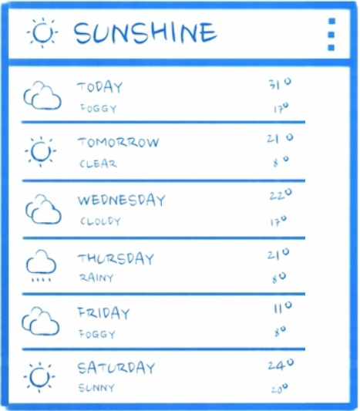
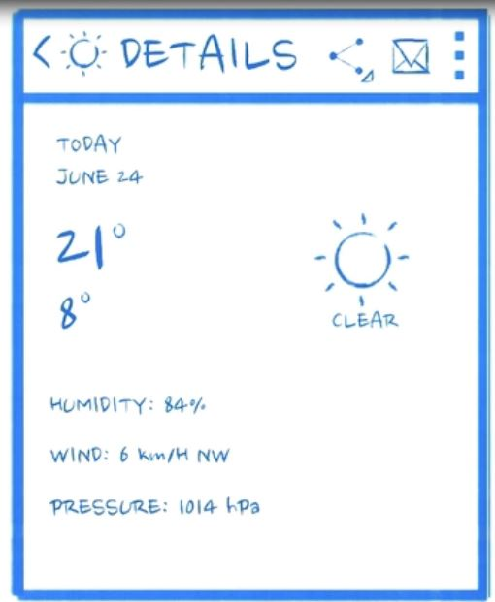
Fragments
One pane UI
Activity 1 Activity 2

Slide 40
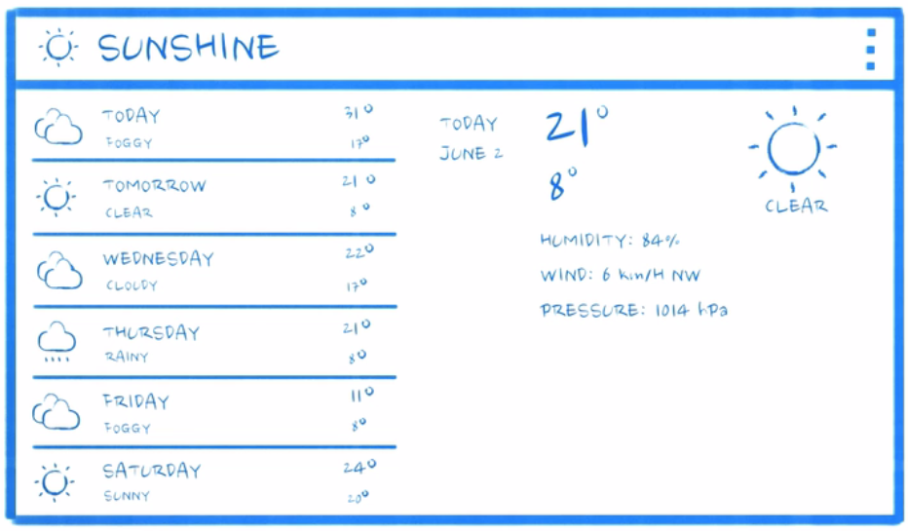
Fragments
Two pane UI

Slide 41
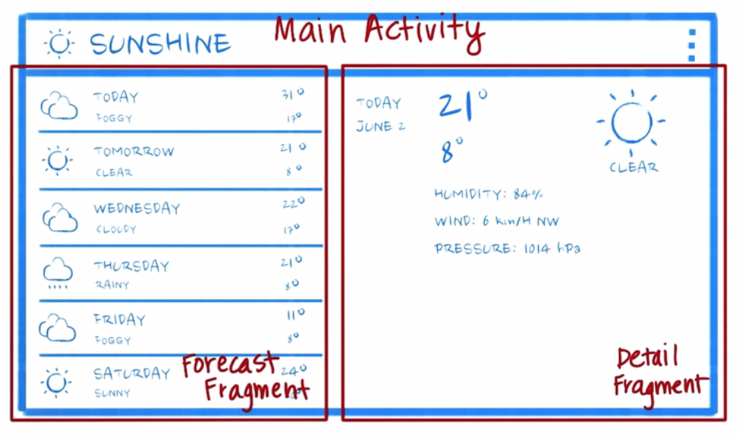
Fragments
Two pane UI

Slide 42
Fragments
Fragment is a piece of an application's user interface or behaviour that can be placed in an Activity which enable more modular activity design.
A fragment has its own layout and its own behaviour with its own lifecycle callbacks.
You can add or remove combine multiple fragments in a single activity
Fragment life cycle is closely related to the lifecycle of its host activity
A fragment can implement a behaviour that has no user interface component.
Fragments were added to the Android API in Honeycomb version of Android which API version 11.

Slide 43
Fragment Life Cycle
Phase I: When a fragment gets created, it goes through the following states:
onAttach() , onCreate() , onCreateView() , onActivityCreated()
Phase II: When the fragment becomes visible, it goes through these states:
onStart() , onResume()
Phase III: When the fragment goes into the background mode, it goes through these states:
onPaused() , onStop()
Phase IV: When the fragment is destroyed, it goes through the following states:
onPaused(), onStop() , onDestroyView() , onDestroy() , onDetach()

Slide 44
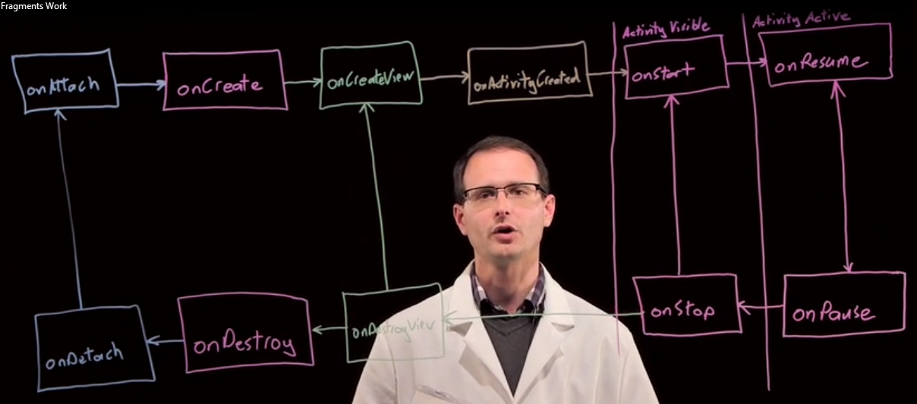
Fragment Life Cycle

Slide 45
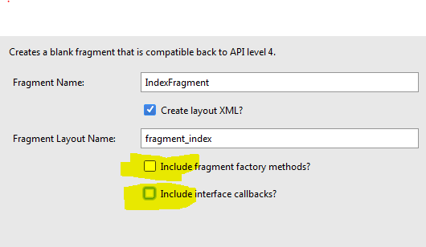
Fragments: Demo
Steps | Instructions
1 | You need create two Fragments. Create a fragment, IndexFragment.java. Right click of project->new->Fragment->Fragment(Blank) Unmark the Option Highlighted in the below Image
2 | Above step would have created an xml layou file: fragment_index.xml. Now add some labels to this xml
3 | Similarly create another fragment, DetailedFragment.java and add some labels to corresponding xml layout

Slide 46
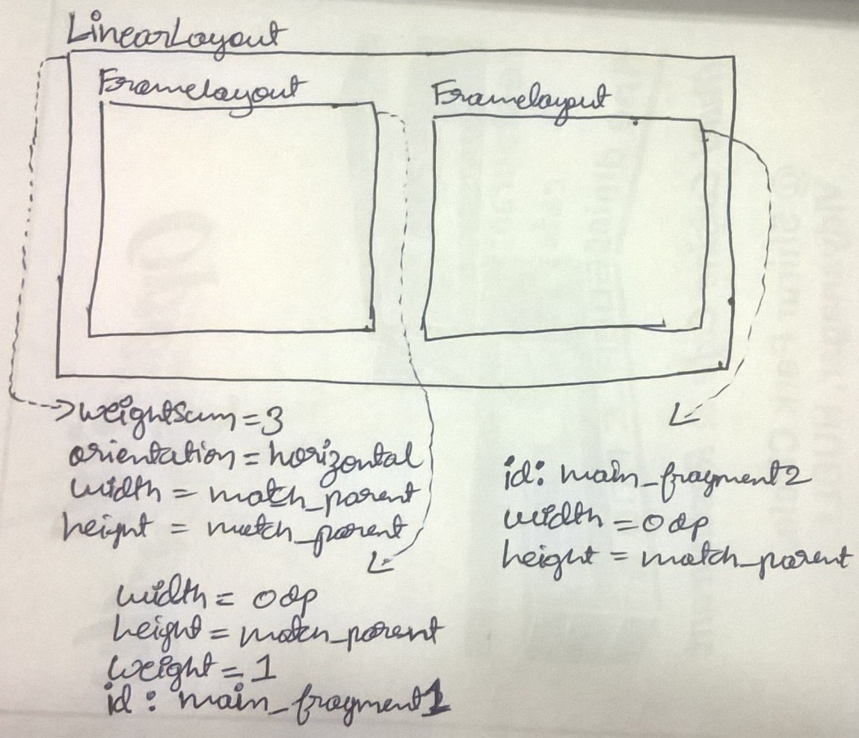
Fragments: Demo
Steps | Instructions
4 | Now create an empty activity FragmentDemoActivity.java
5 | Then go to activity_fragment_demo.xml and create its landscape variation xml file. Modify this xml as per the fig given below
6 | Add a <fragment> within the first frameLayout .i.e id : main_fragment1. Following is code snippet to be included under framelayout
<fragment android:layout_width="wrap_content" android:layout_height="wrap_content" android:name="bvb.android.example.com.practice2016_17.IndexFragment" android:id="@+id/fragment" android:layout_gravity="left|top" tools:layout="@layout/fragment_index" />

Slide 47
Fragments: Demo
Steps | Instructions
7 | Now run the app and launch FragmentDemoActivity.java through modifications in the manifest file
8 | You can also dynamically attach DetailedFragment.java to the activity. To do so, add following code in the onCreate() method of the activity Configuration configuration=getResources().getConfiguration(); if(configuration.orientation==Configuration.ORIENTATION_LANDSCAPE) { Toast.makeText(FragmentDemoActivity.this, "landscape", Toast.LENGTH_SHORT).show(); getSupportFragmentManager().beginTransaction().replace(R.id.main_fragment2, new DetailedFragment()).commit(); }
9 | Once again run the app and test it to display both the fragments.

Slide 48
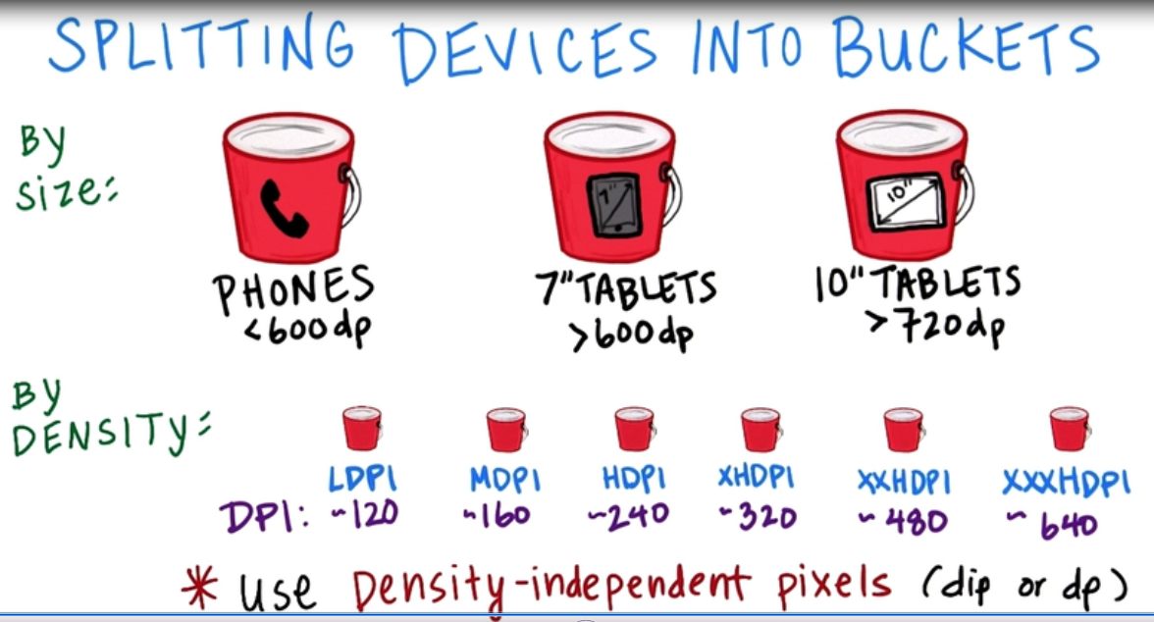
Fragments

Slide 49
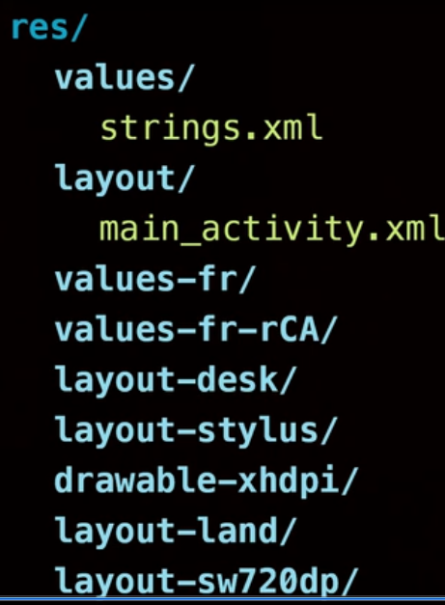
Fragments
Resource folder qualifier

Slide 50
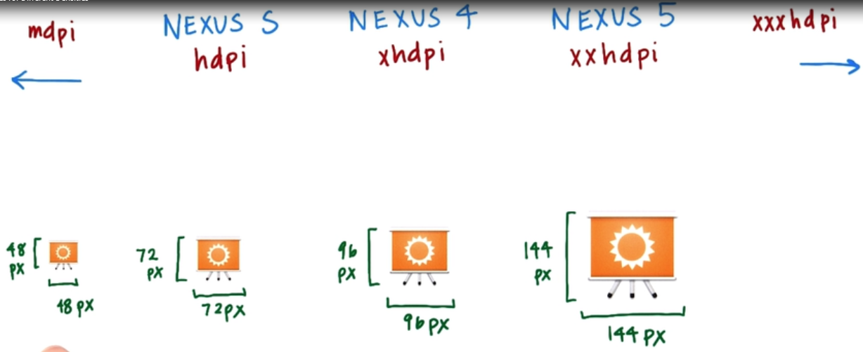
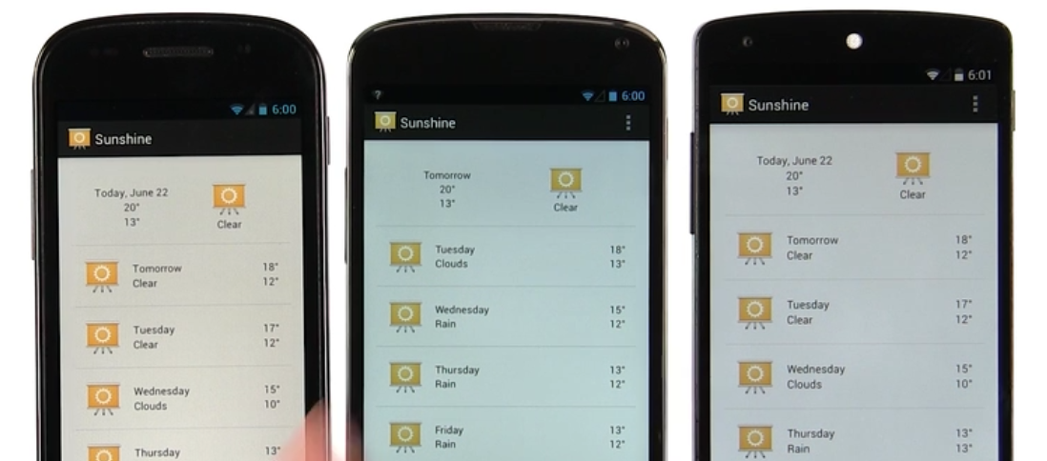
Fragments

Slide 51
Fragments: Lesson Plan minor-1 q.no 2c
Design a dynamic UI that provides 1) “attendance” and “CIE” options for students 2) “course” and “exams” option for staff
Create a single activity that provides dynamic UI. i.e on selecting student, students options are displayed. But on selecting staff, staff’s options are selected.
On selecting “attendance” or “CIE” options, attendance % or CIE score of a student are displayed respectively.
Similarly on selecting “course” or “exam” option, course title or exam dates are displayed respectively.
For solution refer practice2016-17 project from my github,
activities:LP_minor1_2c.java, Staff_Detailed_Activity.java, Student_Deailed_Activity.java
fragments: FirstFragment.java, StaffFragment.java, StudentFragment.java

Slide 52
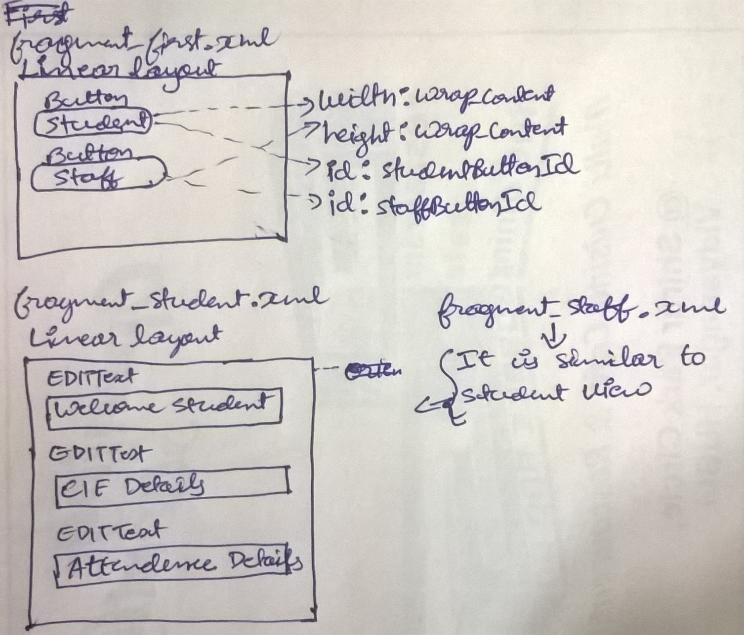
Fragments: Lesson Plan minor-1:q.no 2c
Wireframes

Slide 53
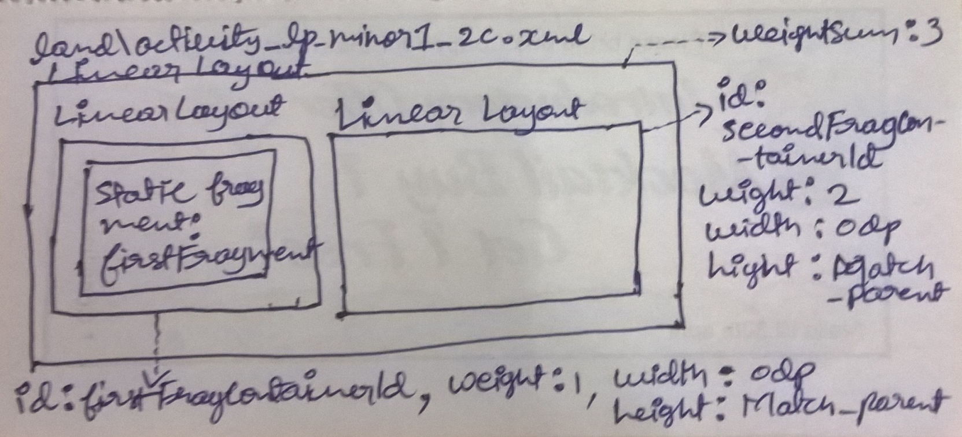
Fragments: Lesson Plan minor-1:q.no 2c
Wireframes

Slide 54
Fragments: Lesson Plan minor-1 q.no 2c
Steps | Instructions
1 | You need create 3 Fragments. Firstly create blank fragment FirstFragment.java as you did before in previously
2 | Design fragment_first.xml as per the wireframes
3 | Add callBack interface(given below) within FirstFragment class. public interface callBack{ public void luanchSecondFragmen(int selectedOption); }
4 | Create fragments StaffFragment.java, StudentFragment.java similarly and design their xml as per wireframes.
5 | Create a blank activity: LP_minor1_2c.java. Then create its landscape variation xml: land\activity_lp_minor1_2c.xml.
6 | Design land\activity_lp_minor1_2c.xml as per the wireframes
7 | implement FirstFragment.callBack in activity: LP_minor1_2c.java . i.e class LP_minor1_2c extends AppCompatActivity implements FirstFragment.callBack

Slide 55
Fragments: Lesson Plan minor-1:q.no 2c
Steps | Instructions
8 | Now override method in luanchSecondFragmen(int selectedOption) in the activity class as given below public void luanchSecondFragmen(int selectedOption){ Configuration configuration=getResources().getConfiguration(); if(configuration.orientation==Configuration.ORIENTATION_LANDSCAPE) { if(selectedOption==1) {//student button in FirstFragment is clicked Toast.makeText(LP_minor1_2c.this, "student fragment", Toast.LENGTH_SHORT).show(); getSupportFragmentManager().beginTransaction().replace(R.id.secondFragConainerId, new StudentFragment()).commit(); } else{//staff button in FirstFragment is clicked Toast.makeText(LP_minor1_2c.this, "staff fragment", Toast.LENGTH_SHORT).show(); getSupportFragmentManager().beginTransaction().replace(R.id.secondFragConainerId, new StaffFragment()).commit(); } } // fill and complete the remaining code as needed
9 | Now add following members to FirstFragment class int mSelectedOption=0; Button mStudetnButtonRef, mStaffButtonRef;

Slide 56
Fragments: Lesson Plan minor-1:q.no 2c
Steps | Instructions
10 | Replace following code in onCreateView() method of FirstFragment View rootView=inflater.inflate(R.layout.fragment_first, container, false); mStudetnButtonRef=(Button)rootView.findViewById(R.id.studetnButtonId); mStudetnButtonRef.setOnClickListener(new View.OnClickListener() { @Override public void onClick(View v) { mSelectedOption=1;//means student button clicked ((callBack)getActivity()).luanchSecondFragmen(mSelectedOption); } }); mStaffButtonRef=(Button)rootView.findViewById(R.id.staffButtonId); mStaffButtonRef.setOnClickListener(new View.OnClickListener() { @Override public void onClick(View v) { mSelectedOption=2;//means staff button clicked ((callBack)getActivity()).luanchSecondFragmen(mSelectedOption); } }); return rootView;
11 | Above steps shall full-fill the solution for landscape mode. Further, the other activities need to be created to full-fill portrait mode solution. This will be homework and you can refer the solution in the project

Slide 57
Fragments: Lesson Plan minor-1 q.no 1c
Consider the course information of a student.
Design a UI to accept CIE, SEE, and credits information for several courses one by one. Draw the snap shots
Design the data structure to store the information obtained from UI
The UI should display the SGP at the end. Also appropriate message to be flashed when user enters incorrect information for SEE and CIE marks(Max 50 Marks)
Write android programs performing above points.
For solution refer practice2016-17 project from my github,
activity: lp_minor1_1c_Activity.java

